Slide 1
Wage and Hour Division
Laura A. Fortman
Deputy Administrator

Slide 2
WHD Mission
Promote and achieve compliance with labor standards to protect and enhance the welfare of the Nation’s workforce.

Slide 3
Need for Strategic Enforcement
Need for Resources
>
Resources
= Need for Strategic Enforcement

Slide 4
The Fissured Workplace

Slide 5
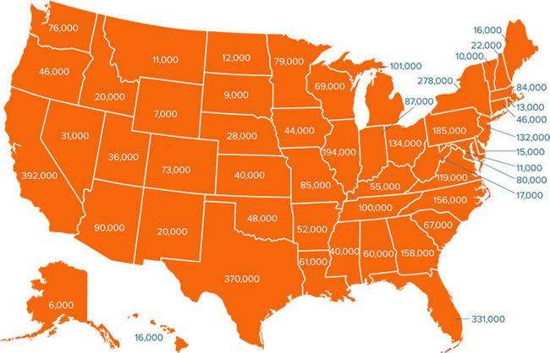
Overtime Final Rule
Overtime updates will extend protections to 4.2 million workers across the country

Slide 6
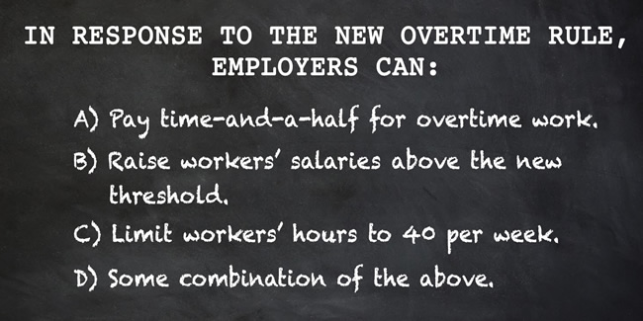
Overtime Final Rule

Slide 7
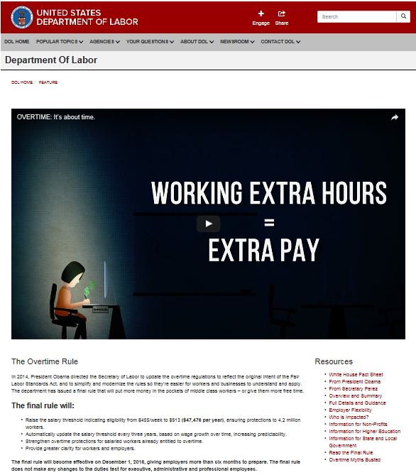
Overtime Final Rule
Or call:
1-866-4US-WAGE (1-866-487-9243)
Visit our website:
www.dol.gov/overtime

Slide 8
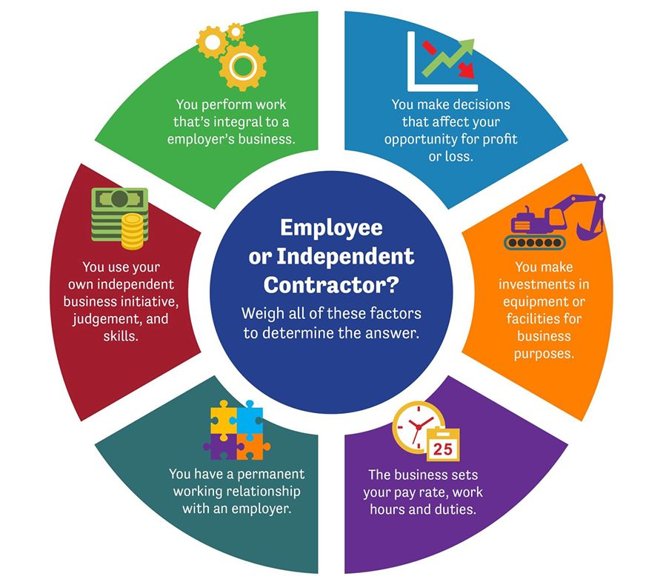
Misclassification

Slide 9
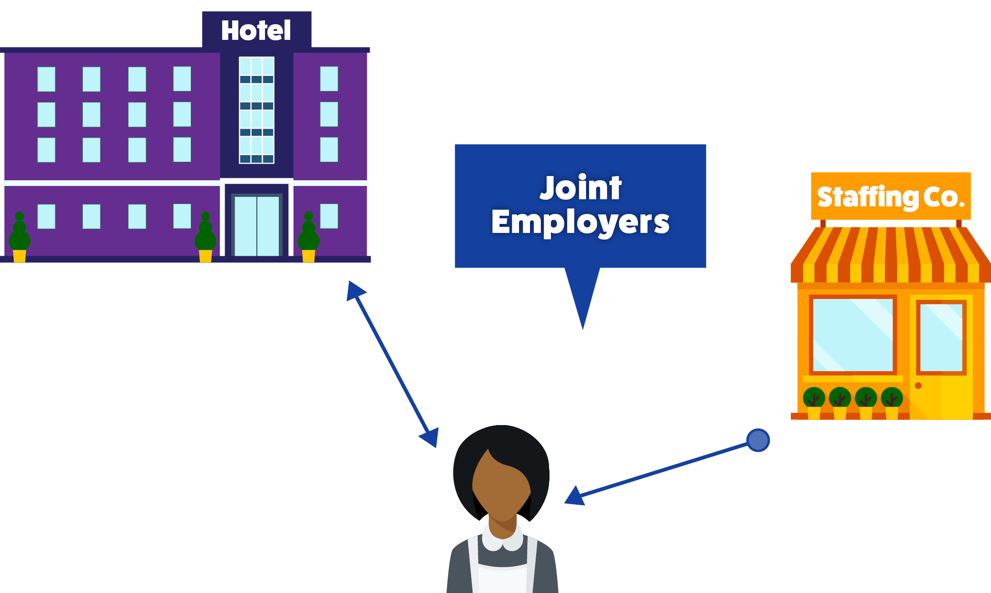
Joint Employment

Slide 10
Home Care
www.dol.gov/whd/homecare

Slide 11
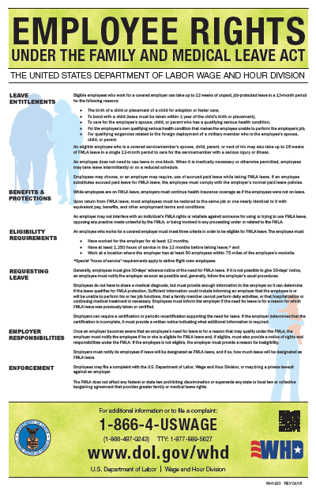
Family and Medical Leave Act
www.dol.gov/whd/fmla

Slide 12
Questions?

